Slide 1
Lushootseed Lesson 3
Summer 2021 – Natosha Gobin
Week One
July 12-16

Slide 2
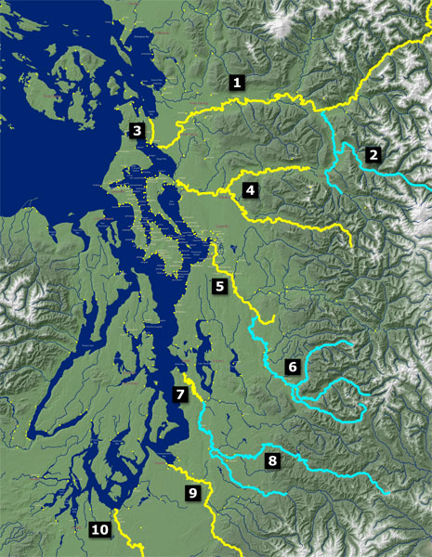

Slide 3
1. sqaǰət
saʔkʷbixʷ (saʔkʷmixʷ)
suyaƛ̕
swədəbš (swənəmš)
stuləkʷabš (stuləgʷamš)
sduhubš (snuhumš)
sdukʷalbixʷ (snukʷalkmixʷ)
-abš/əbš
(-amš/əmš)
– group of people
-bixʷ
(mixʷ)
group of living beings

Slide 4
1. sqaǰət
saʔkʷbixʷ (saʔkʷmixʷ)
suyaƛ̕
stuləkʷabš (stuləgʷamš)
sduhubš (snuhumš)
sdukʷalbixʷ (snukʷalkmixʷ)
dxʷdəw̓abš (nxʷnəw̓amš/
dxʷdəw̓amš)
bəq̓əlšuɬ (məqəlšuɬ)
puyaləpabš (puyaləpamš)
dxʷsqʷaliʔabš (nxʷsqʷaliʔamš)
suq̓ʷabš (suq̓ʷamš)
sqʷax̌sədəbš (sqʷax̌sənəmš)
-abš/əbš
(-amš/əmš)
– group of people
-bixʷ
(mixʷ)
group of living beings

Slide 5
dxʷlilap
dxʷ- to/towards
lil far
-ap bottom

Slide 6
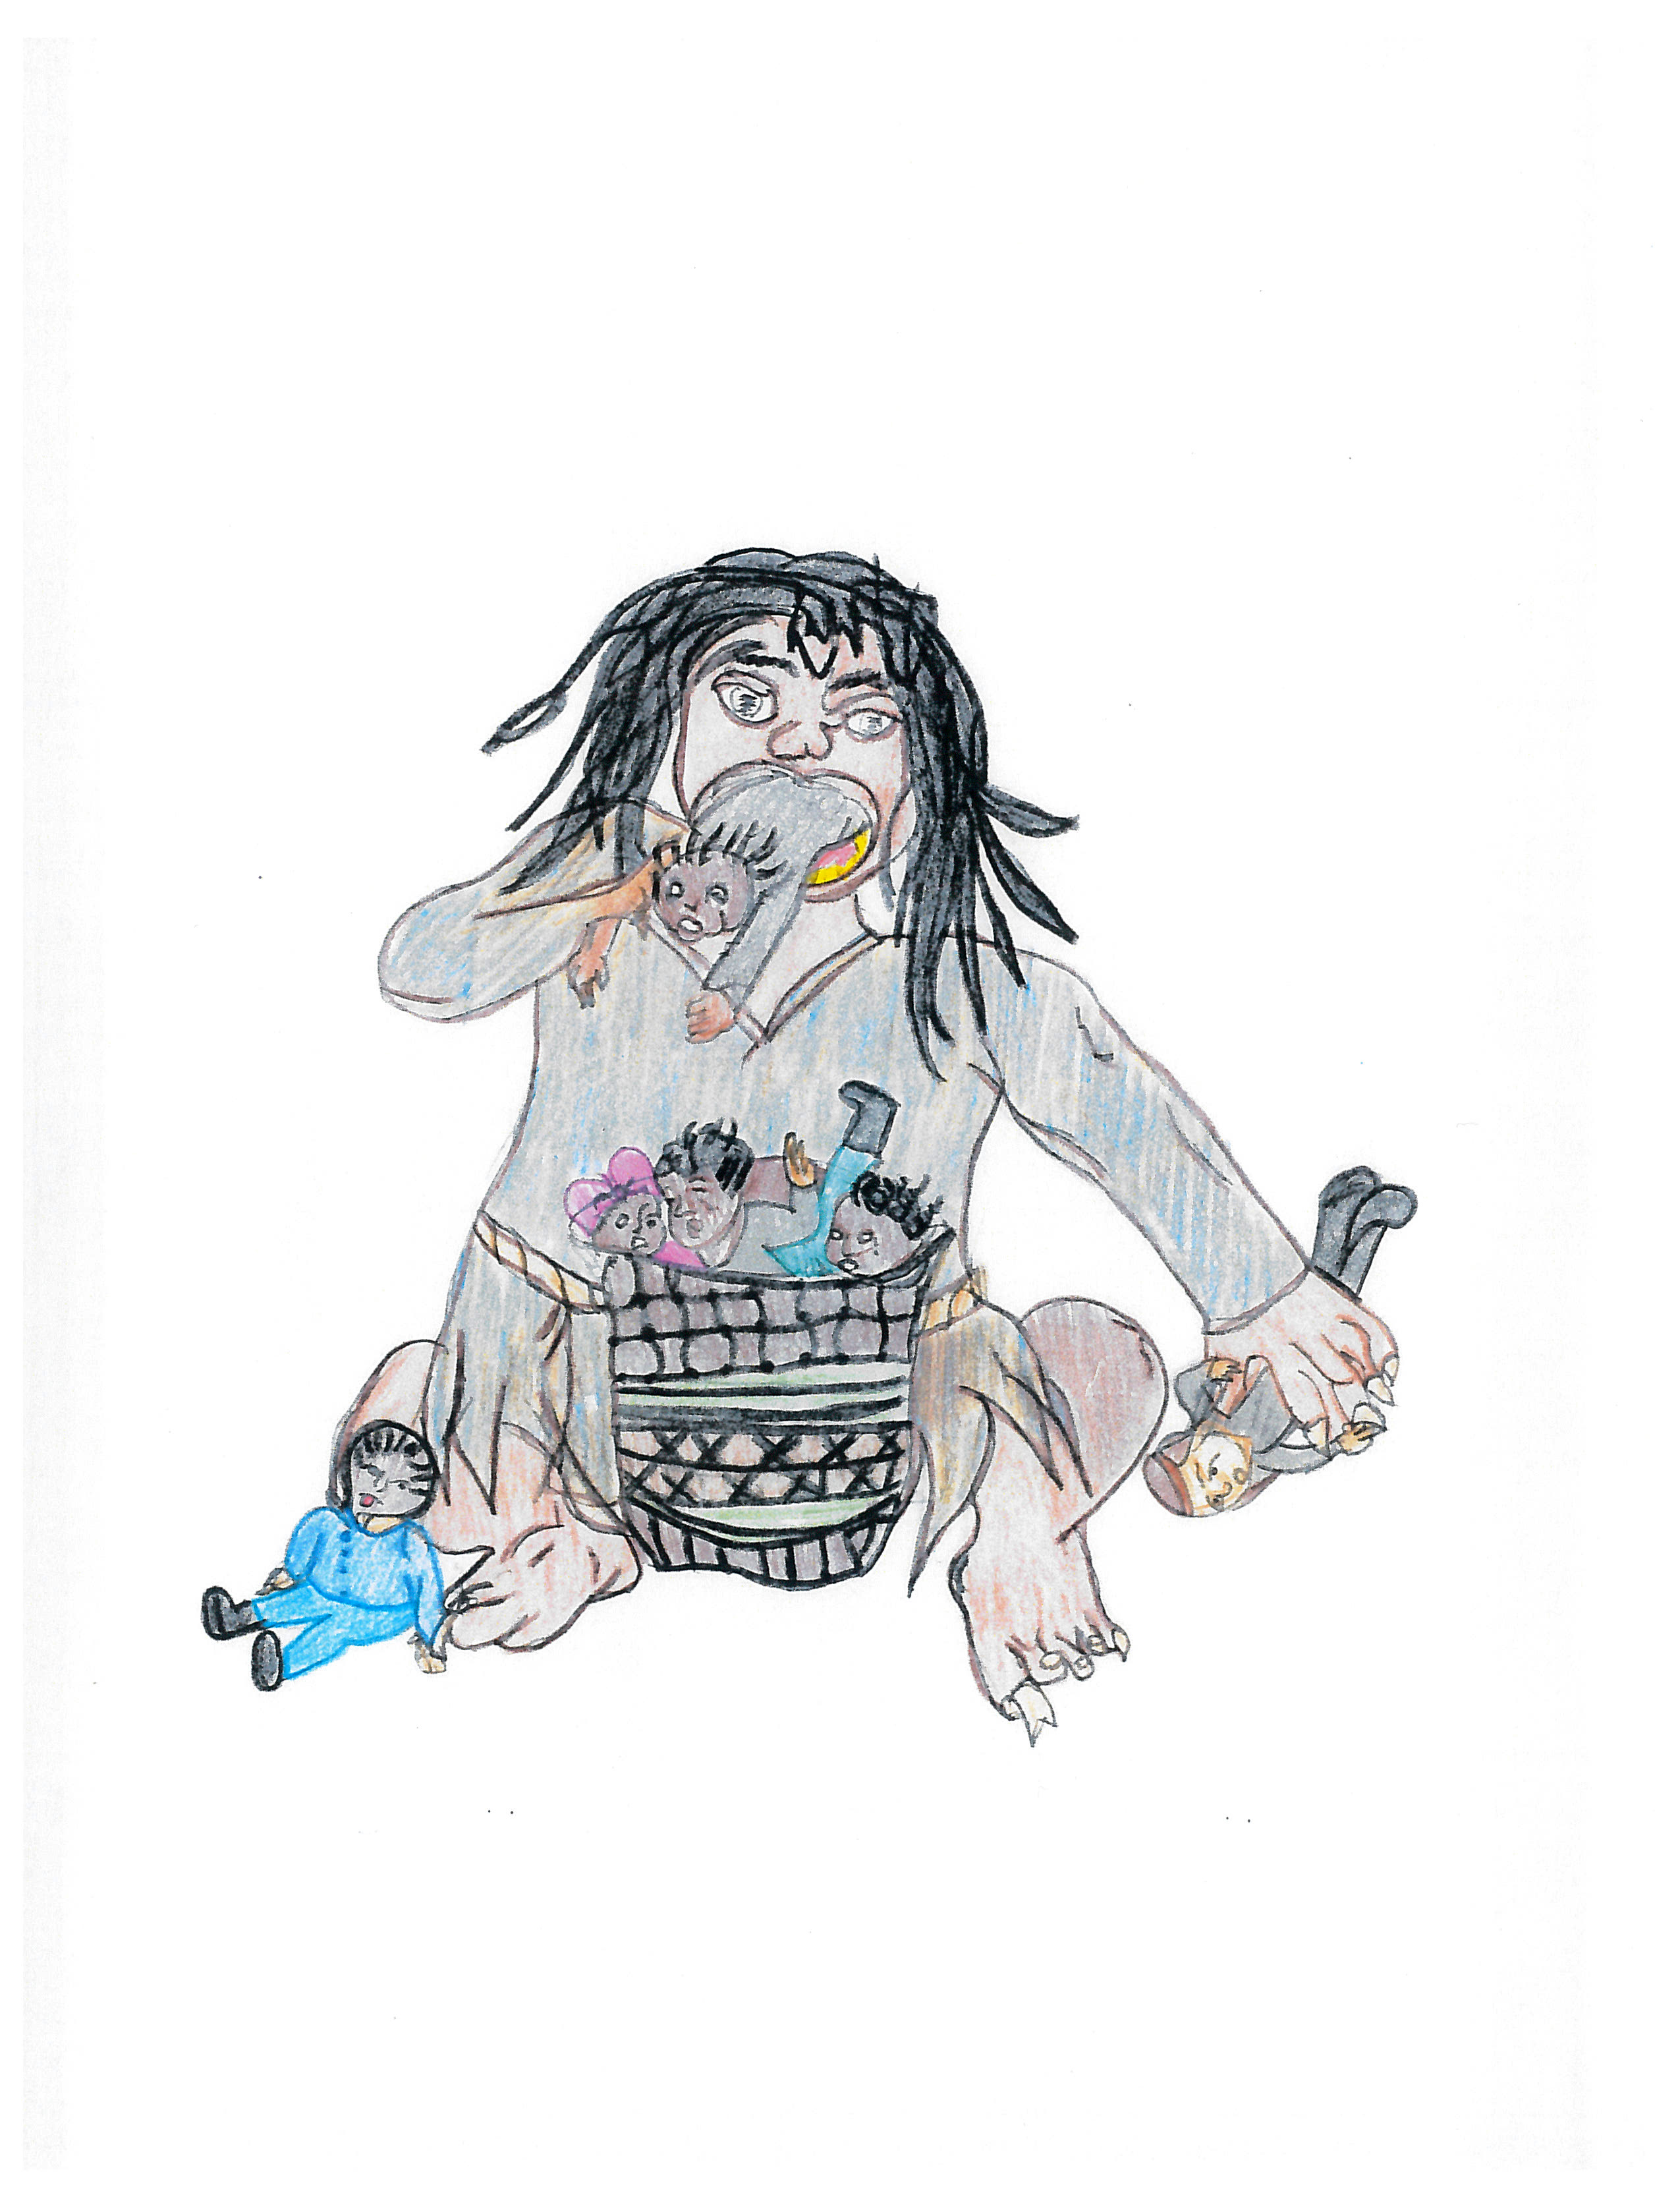
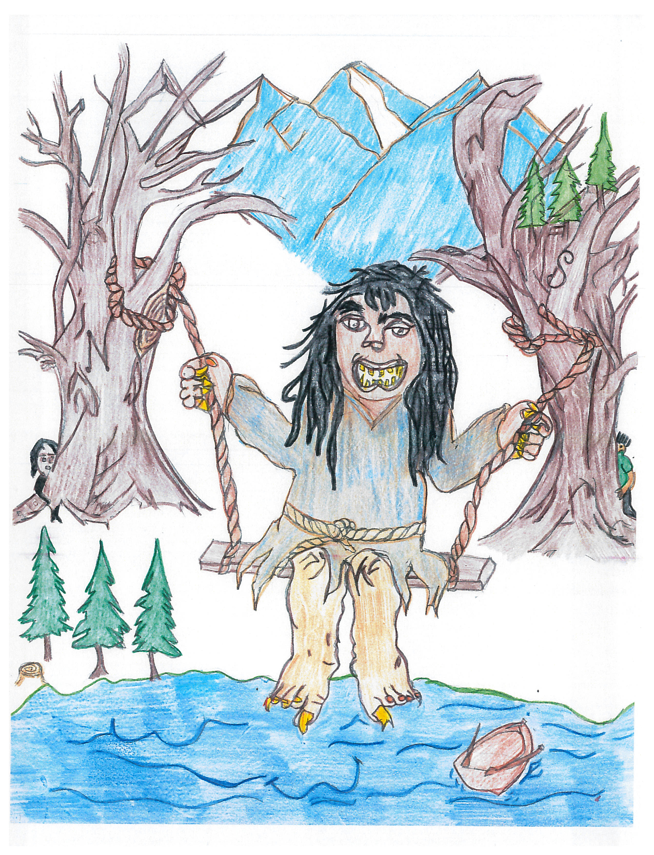
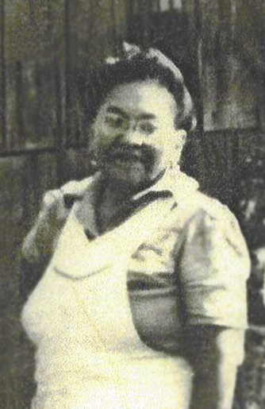
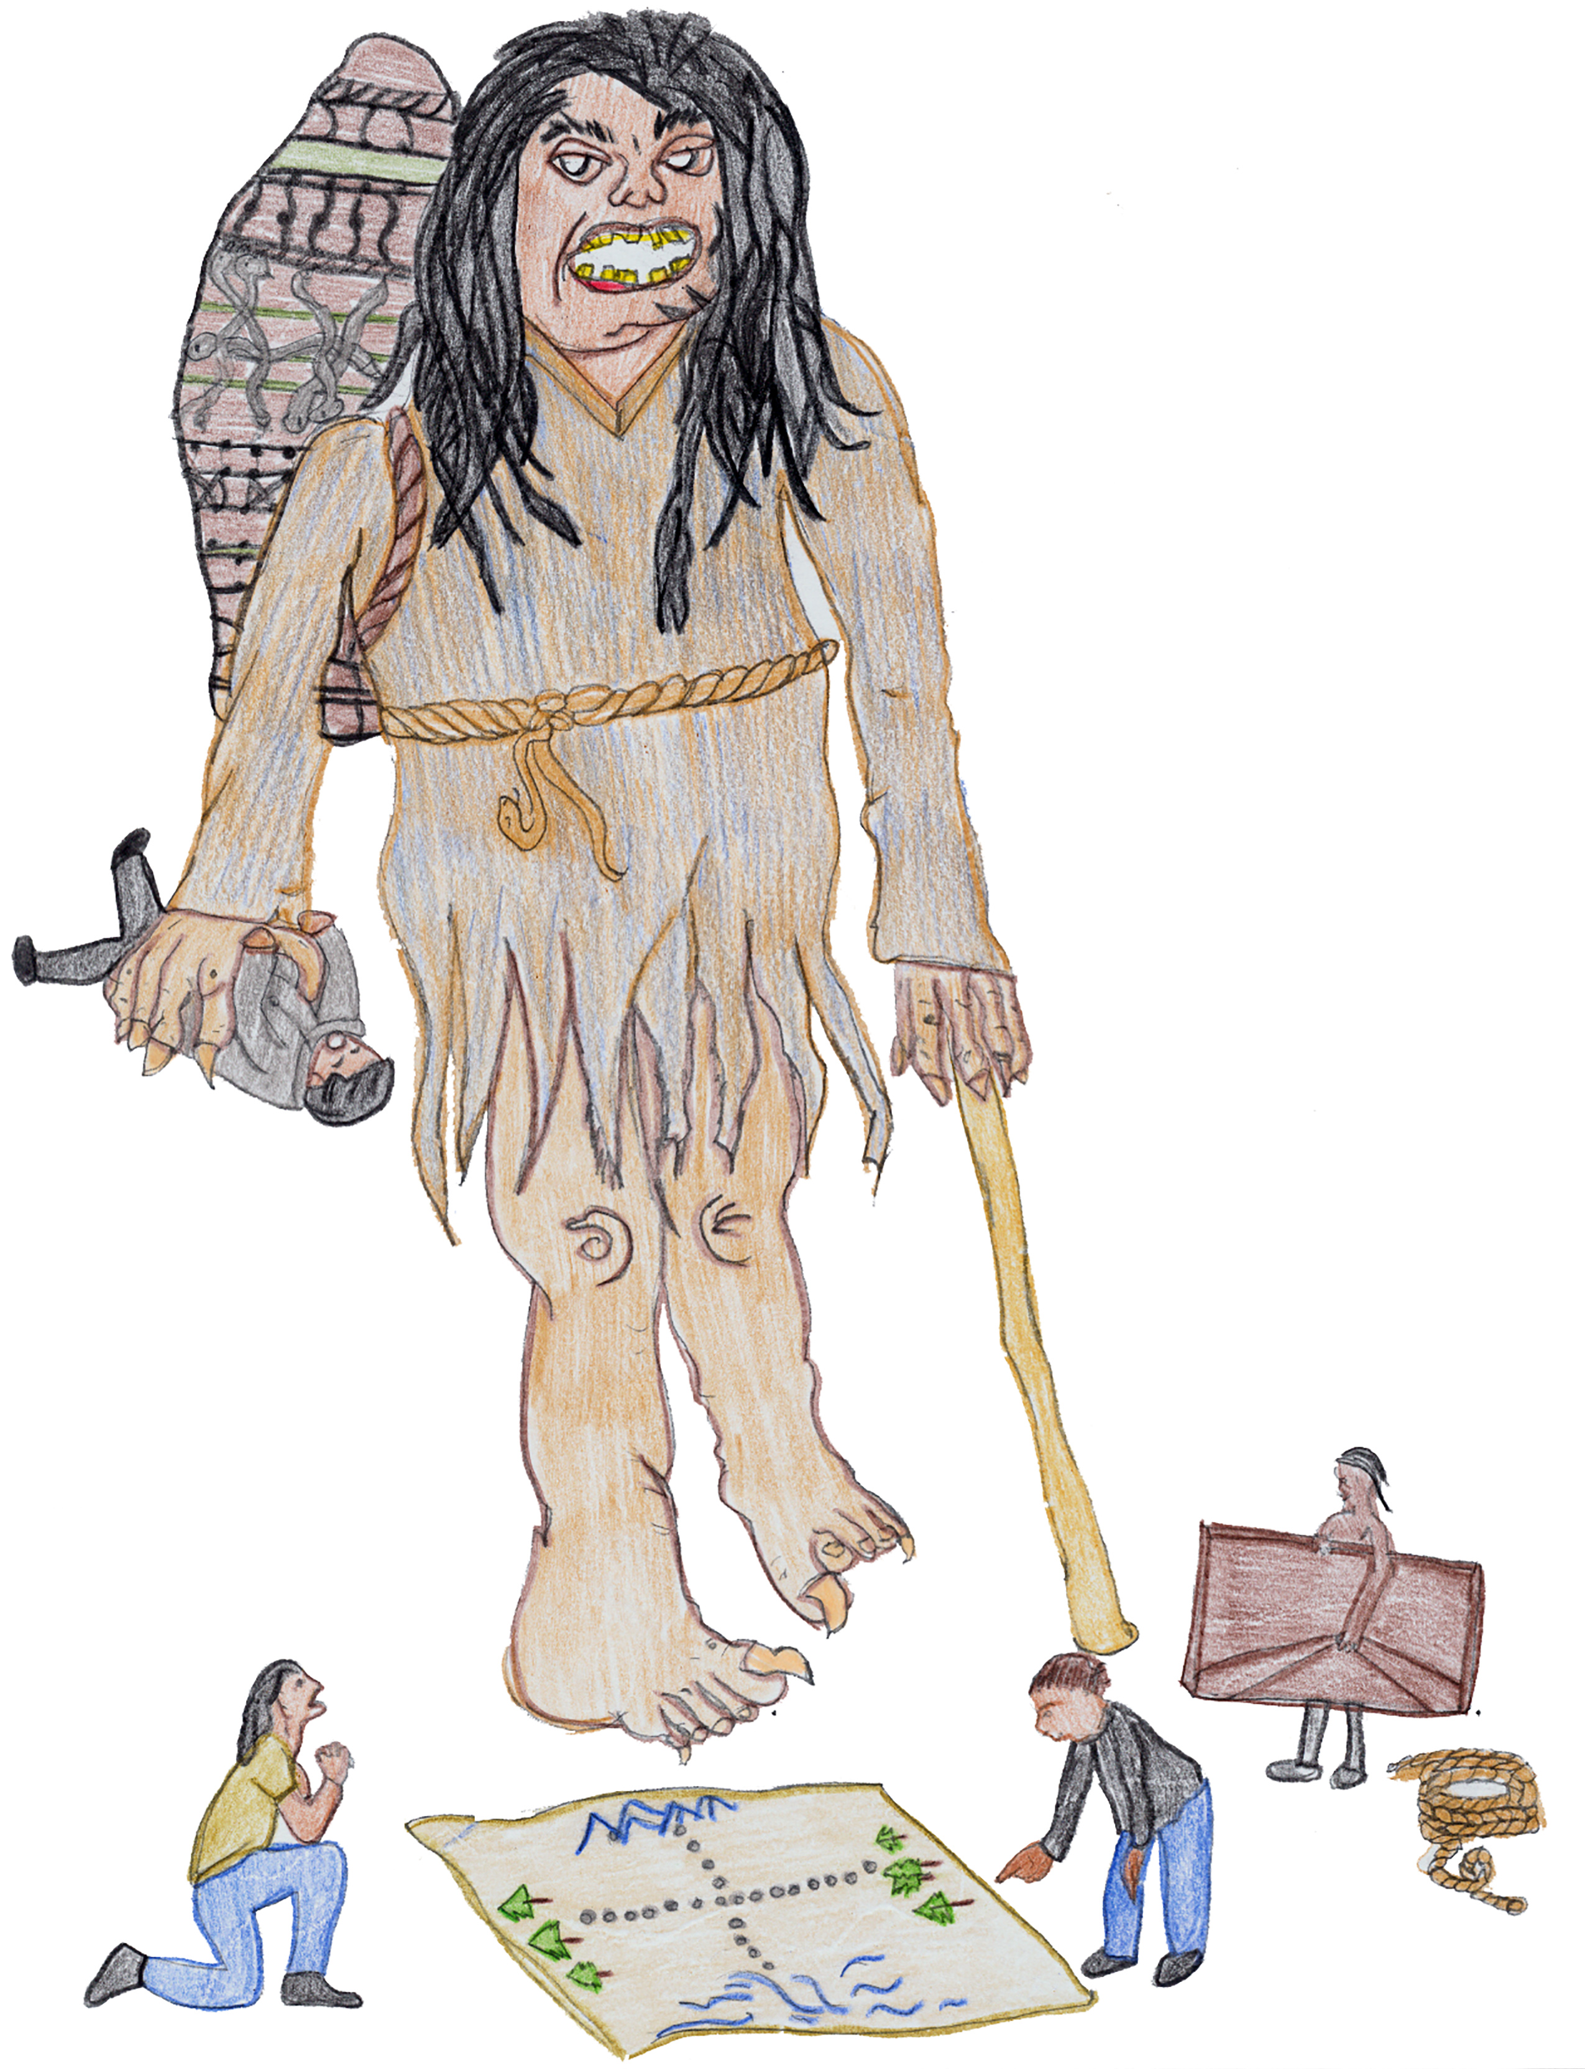
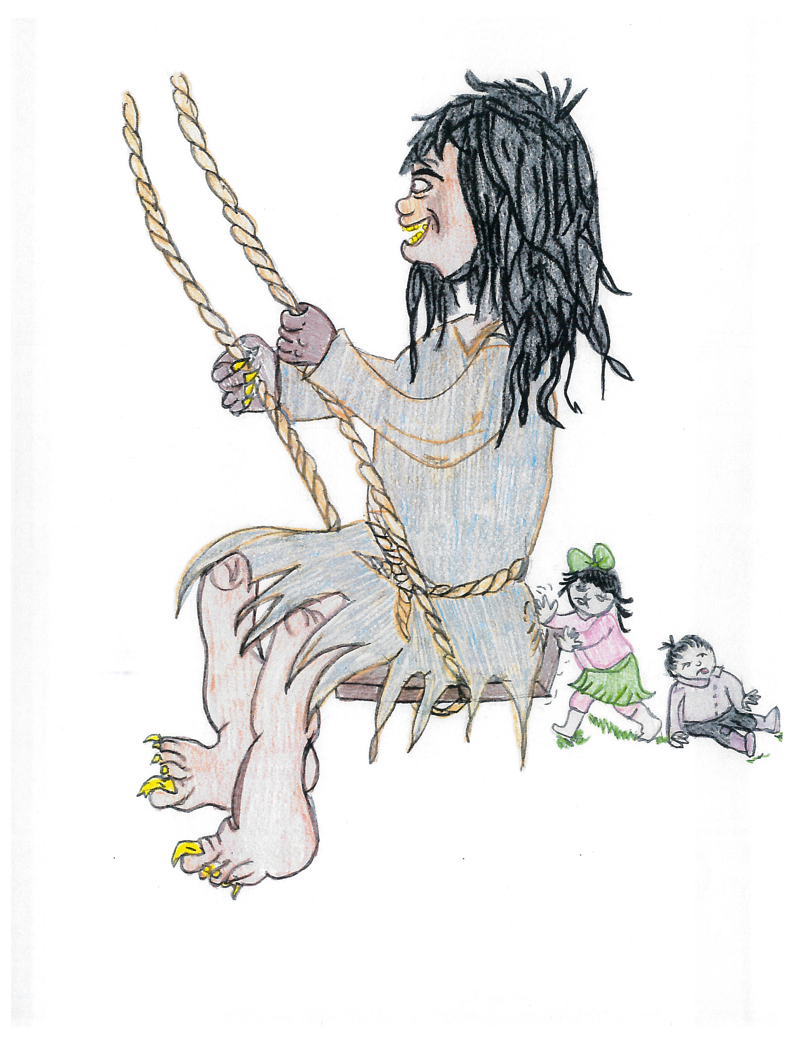
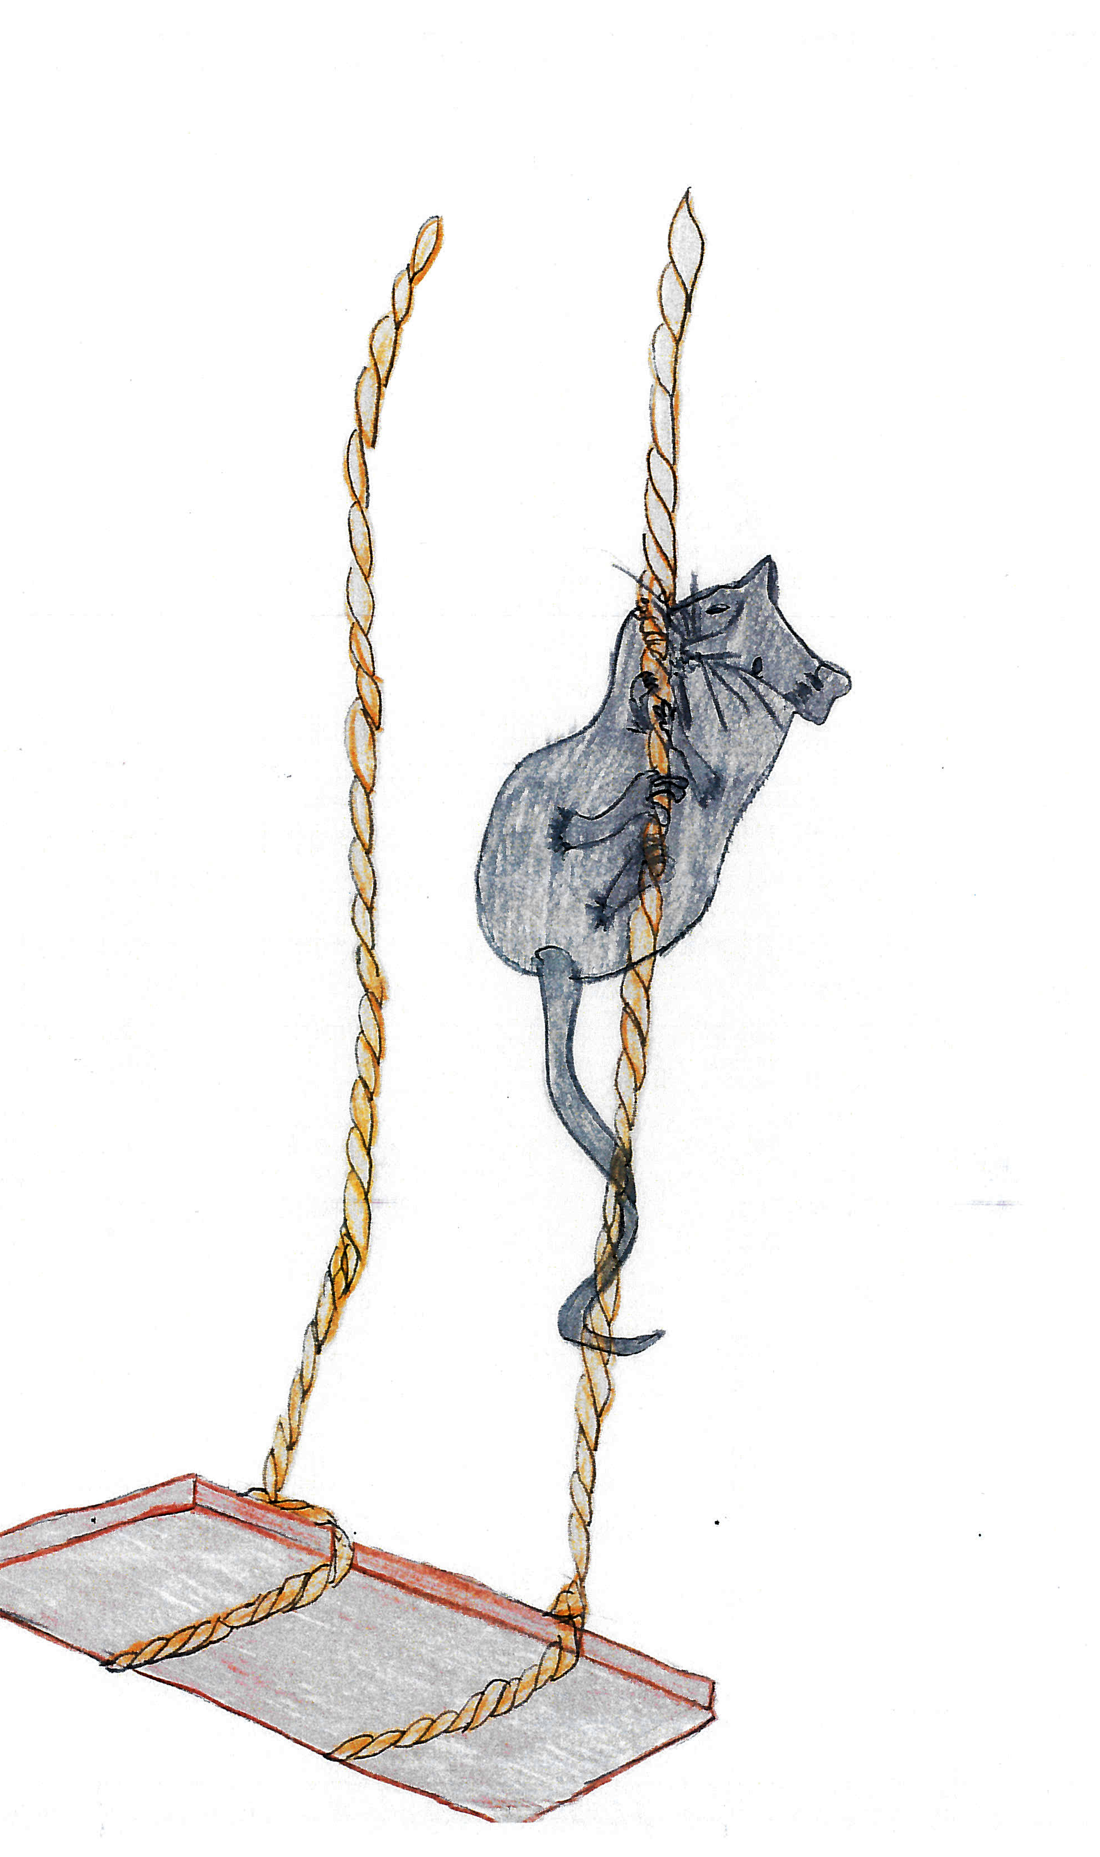
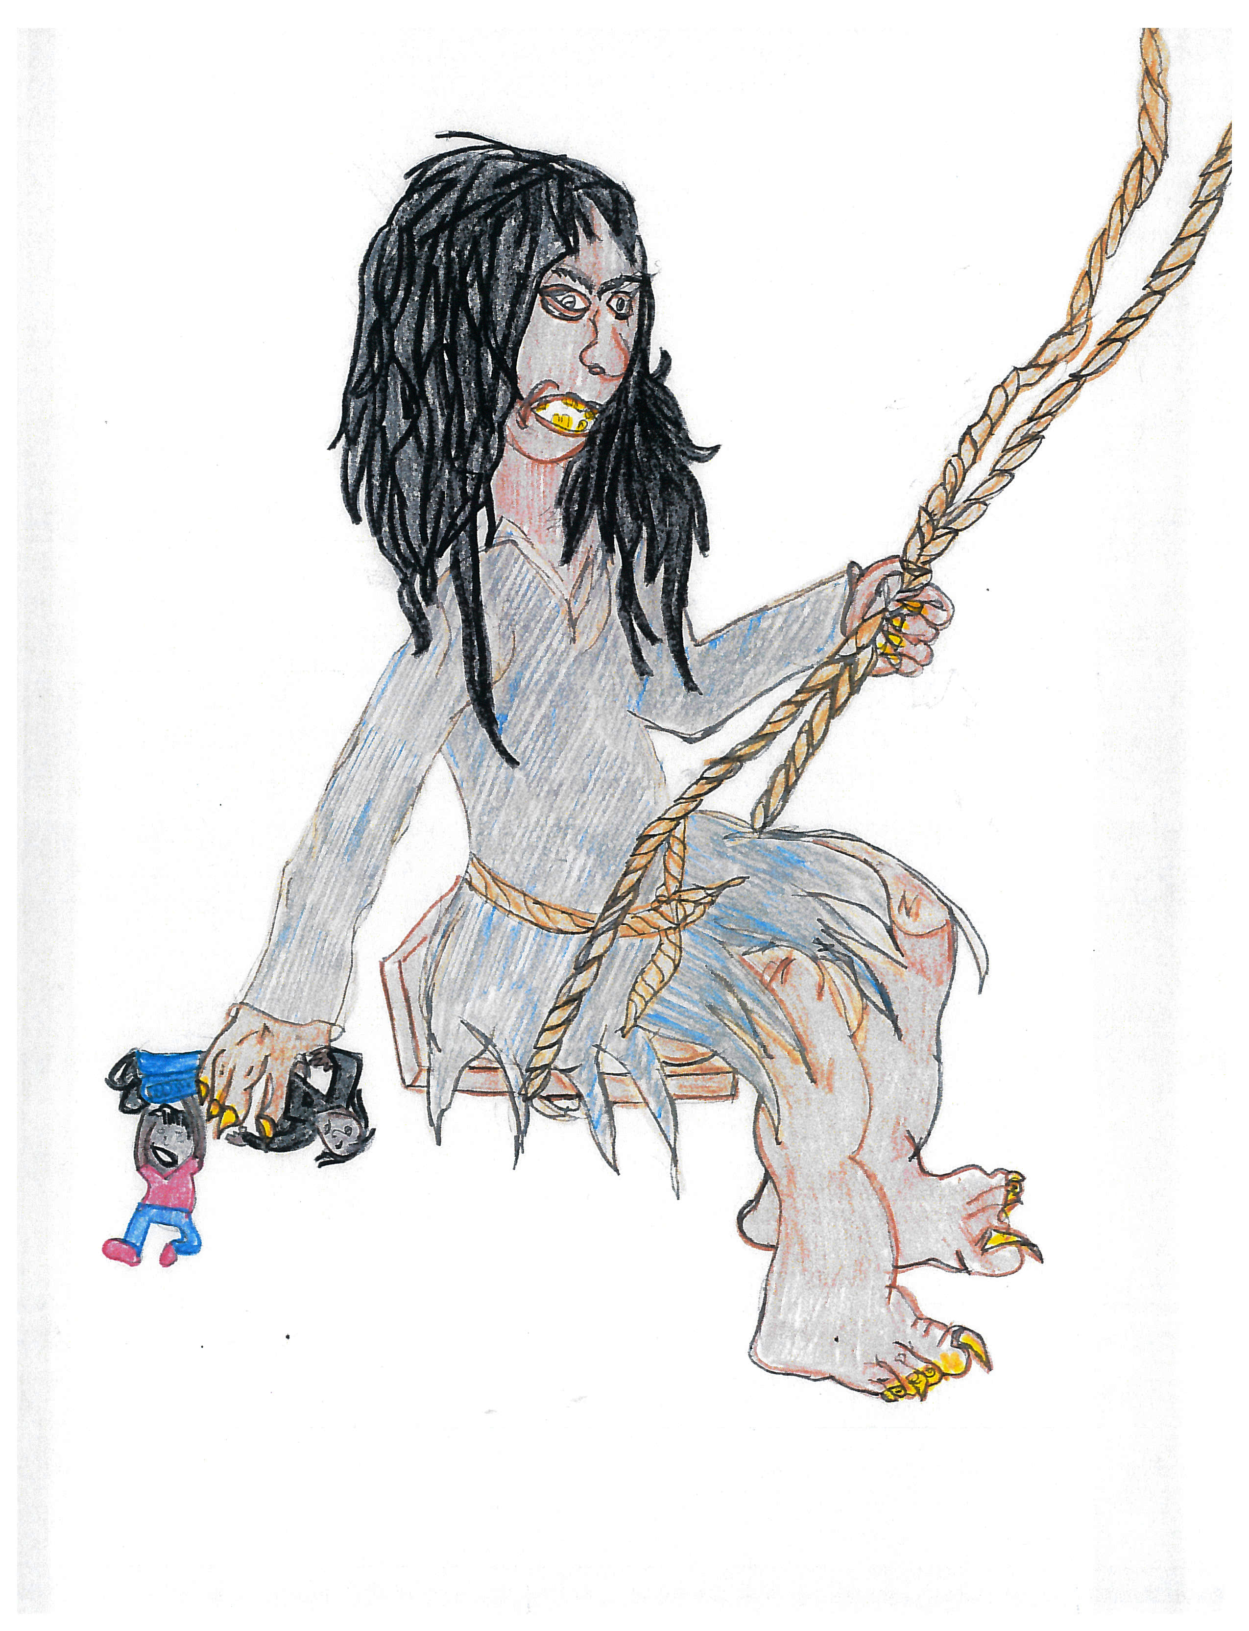
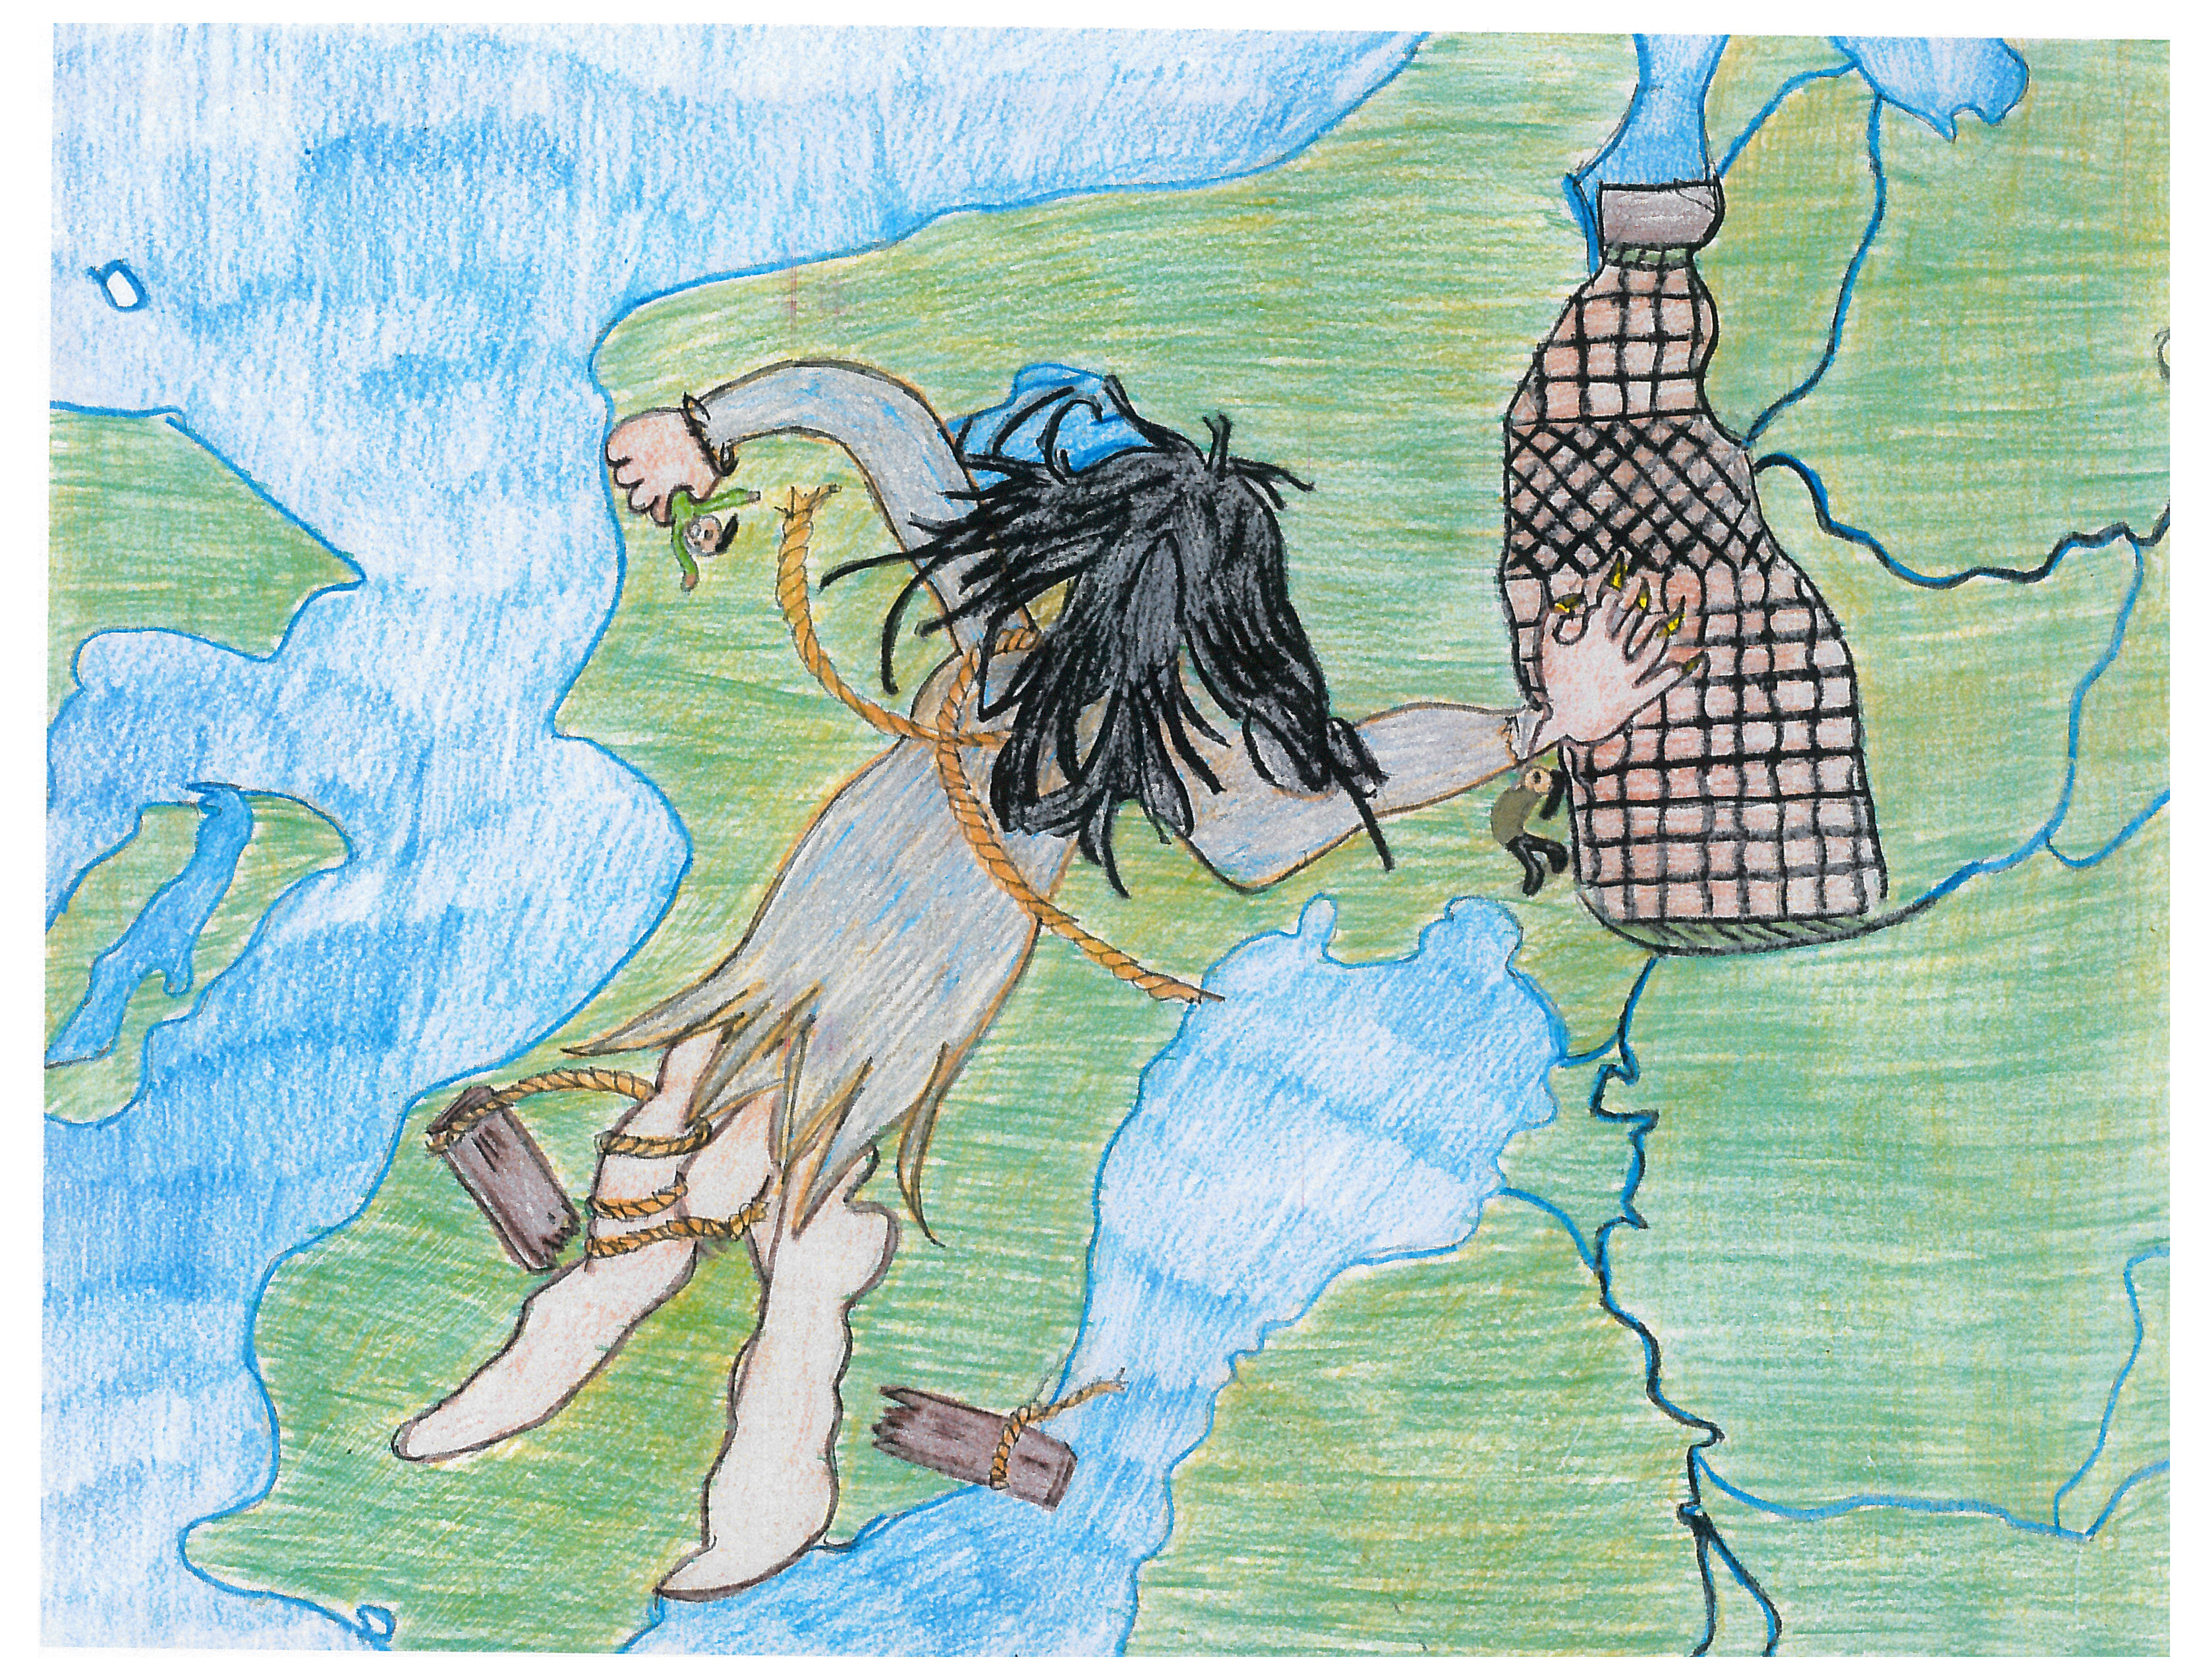

Slide 8
Lushootseed department resources
Michele Balagot, Lushootseed Department Manager
mbalagot@tulaliptribes-nsn.gov
360-716-4495
Tulalip Tribes Lushootseed Website:
www.tulaliplushootseed.com
Tulalip TV Videos:
https://www.tulaliptv.com/category/lushootseed/#

