Slide 1
Lushootseed Lesson 1
Summer 2021 – Natosha Gobin
Week One
July 12-16

Slide 2
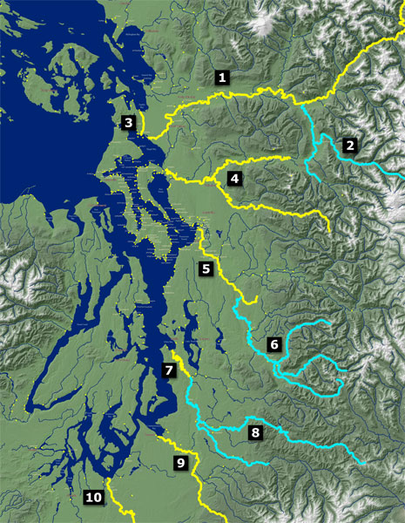

Slide 3
1. sqaǰət
saʔkʷbixʷ (saʔkʷmixʷ)
suyaƛ̕
swədəbš (swənəmš)
stuləkʷabš (stuləgʷamš)
sduhubš (snuhumš)
sdukʷalbixʷ (snukʷalkmixʷ)

Slide 4
Michele Balagot, Lushootseed Department Manager
mbalagot@tulaliptribes-nsn.gov
360-716-4495
Tulalip Tribes Lushootseed Website:
www.tulaliplushootseed.com
Tulalip TV Videos:
https://www.tulaliptv.com/category/lushootseed/#

